Slide 1
Section 4
Data Storage

Slide 2
Topics covered
4.1 Data Storage
4.2 Types of memory
4.3 Memory organization
4.4 Magnetic Disk Storage
4.5 Optical Disk Storage
Notes:
CPU Central Processing Unit or Microprocessor

Slide 3
4.1 Data storage
Consist of a read/write mechanism and a storage medium
  Device controller provides interface
Primary storage devices
  Support immediate execution of programs
Secondary storage devices
  Provide long-term storage of programs and data

Slide 4
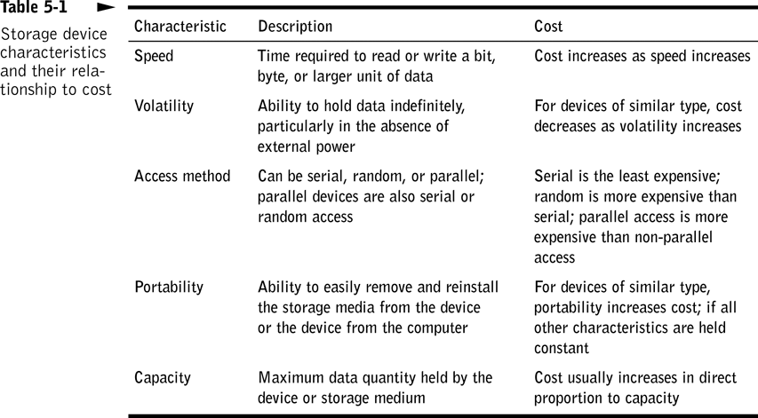

Slide 5
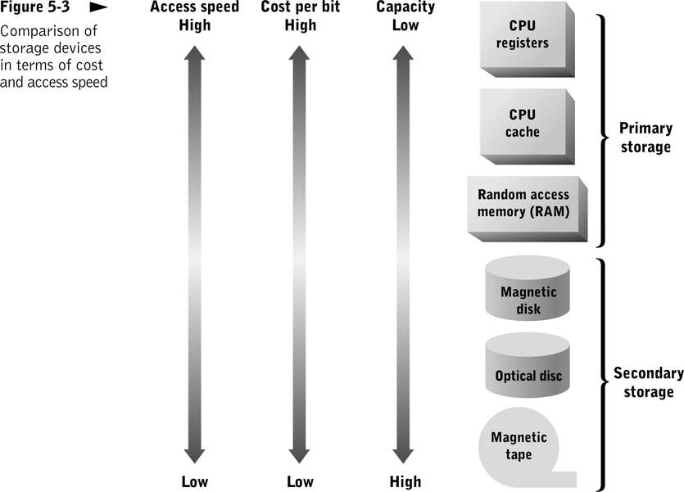
Memory-Storage Hierarchy

Slide 6
Disk Storage Systems
Non-volatile; data remains when computer is off
Usually much bigger than main memory
Separate from the computer itself
Usually rotating disks
  Hard disk, floppy disk, CD-ROM
  Much slower than main memory
    Data access must wait for seek time (head positioning)
Notes:
Before computers there were rooms full of filing cabinets.
Space reduction big + for computers.
1 CD can store 500 books.
Reliability of disk drives has improved (very rare crash)
Allows reading and writing of data
2 common ways of storing data magnetic material (1 if magnetised) Optical (spot or pit does not reflect laser light 0)

Slide 7
4.2 Types of Memory
Also known as primary storage and main memory
  Often expressed as random-access memory (RAM)
  Not part of the CPU
Holds data and instructions for processing
Stores information only as long as the program is in operation (Volatile)
Notes:
Volatile – non permanent
Blackboard for short term

Slide 8
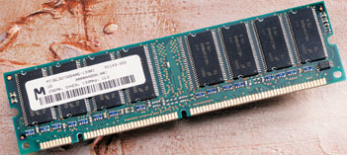
Random Access Memory
Packaged on circuit boards
  Single in-line memory modules (SIMMS)
  Dual in-line memory modules (DIMMS)
Data can be accessed randomly
  Memory address 10 can be accessed as quickly as memory address 10,000,000
Notes:
Amount of memory critical as larger files are used (multimedia) now standard 256K or 512K
Capacity limit Depends on the motherboard
Different chips have different speeds and may not work on your PC
SIMMS – easy to upgrade
SIMMS – one line of contacts

Slide 9
Types of RAM
Static RAM
  Retains its contents with intervention from CPU.
  Faster and more expensive than DRAM
Dynamic RAM
  Must be continuously refreshed by CPU or it loses its contents
  Used for personal computer memory
Notes:
SRAM - Typically used for Level 2 cache

Slide 10
Read-Only Memory (ROM)
Contains programs and data permanently recorded into memory at the factory
  Cannot be changed by user
  Not volatile: contents do not disappear when power is lost
Programmable ROM (PROM) chips
  Some instructions on chip can be changed
Notes:
Bootstrap program on ROM
PROM - E.G. BIOS – basic Input Output Software

Slide 11
Flash Memory
Nonvolatile RAM
  Used in cellular phones, digital cameras, and some handheld computers
  Flash memory chips resemble credit cards
  Smaller than disk drive and require less power
Notes:
Mass storage using mechanical parts to read data is slower so flash stores data on silicon. Also heavy.
More expensive – becoming more common. Cameras, phones, music players.

Slide 12
Memory Cache
A small block of high-speed SRAM memory
  Stores most frequently and most recently used data and instructions
Microprocessor looks for what it needs in cache first
  Transferred from cache much faster than from memory
  If not in cache, control unit retrieves from memory
    The more cache “hits” the faster the system performance
Notes:
CPU much faster than RAM memory can supply data
Again slower to get 1 memory location at a time than to get block of data from memory

Slide 13

Processor Cache
Internal (Level 1) cache built into microprocessor
  Fastest access, but highest cost
External (Level 2) cache on separate chip
  Incorporated into processor on some current microprocessors
Notes:
L1 takes up space on fabrication of CPU
L2 located nearer CPU with specialized bus connection

Slide 14
4.3 Memory organization
Cells = manageable units (typically 8 bits) into which a computer’s main memory is arranged.
High-order end = the left end of the conceptual row in which the contents of a cell are laid out.
Low-order end = the right end of the conceptual row in which the contents of a cell are laid out.
  Least significant bit = the last bit at the low-order end.

Slide 15

The organization of a byte-size memory cell

Slide 16
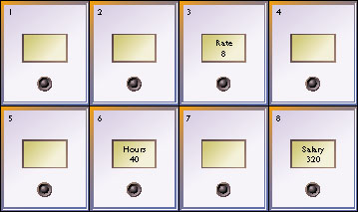
Memory Addresses
Each memory location has an address
  A unique number, much like a mailbox
RAM
  Memory where any cell can be accessed independently
Referred to by number
  Programming languages use a symbolic (named) address, such as Hours or Salary

Slide 17
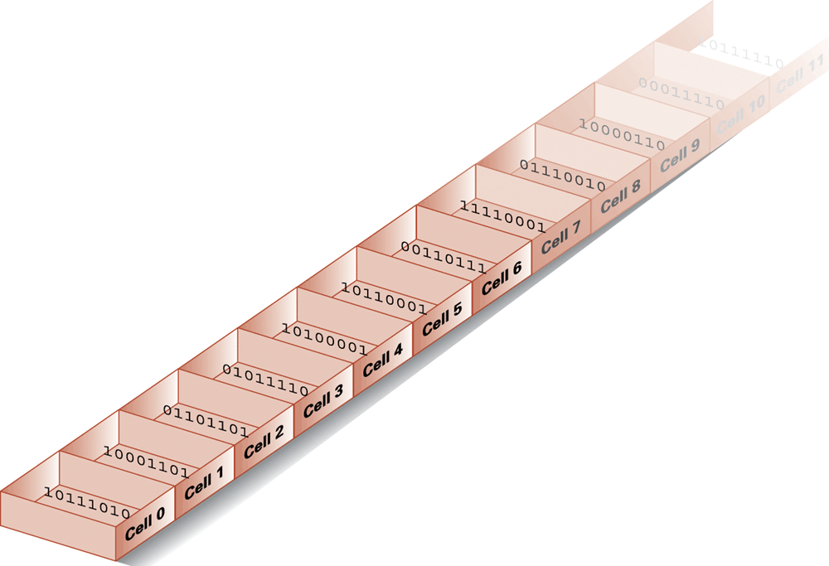
Memory cells arranged by address

Slide 18
RAM Performance
Critical performance characteristics
  Access speed
  Data transfer unit size
Must closely match CPU speed and word size to avoid wait states
To bridge performance gap between memory and microprocessors
  Read-ahead memory access
  Synchronous read operations
  On-chip memory caches

Slide 19
Memory Packaging
Dual in-line packages (DIPs)
  Early RAM and ROM circuits
Single in-line memory module (SIMM)
  Standard RAM package in late 1980s
Double in-line memory module (DIMM)
  Newer packaging standard
  A SIMM with independent electrical contacts on both sides of the module

Slide 20
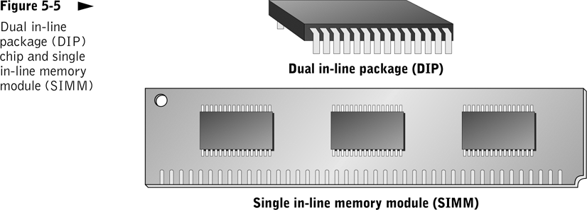

Slide 21
4.4 Magnetic Storage
Exploits duality of magnetism and electricity
  Converts electrical signals into magnetic charges
  Captures magnetic charge on a storage medium
  Later regenerates electrical current from stored magnetic charge
Polarity of magnetic charge represents bit values zero and one

Slide 22
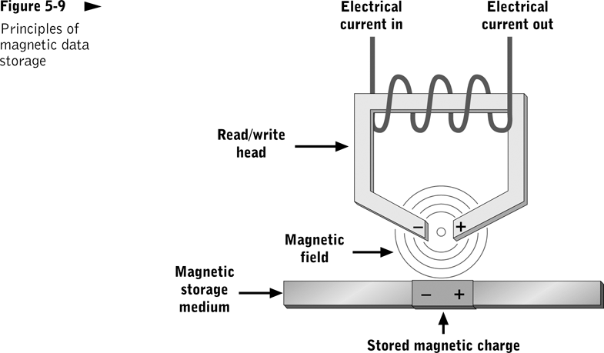

Slide 23
Hard Disks
Rigid platter coated with magnetic oxide
  Several can be combined into a disk pack
Disk drive - a device that allows data to be read from or written to a disk
  Disk drive for personal computers contained within computer housing
  Large computer systems may have several external disk drives
Notes:
Covered airtight sealed (made in clean room) so is free from dust or magnetic fields and has greater capacity
Access arm hovers and read/write head over platter
Capacity increasing all time MB (Past) -GB (current) – TBytes (Future)
Extra space now needed for videos, music

Slide 24
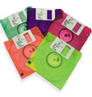

Diskettes
Made of flexible Mylar and coated with iron oxide
Has protection of rigid plastic jacket
3 ½” diskette holds 1.44 MB of data
High-capacity variations
  Sony’s HiFD holds 200 MB
  Imation’s SuperDisk available in 120 and 240 MB versions
  Iomega’s Zip drive available in 100, 250, and 750 MB versions
Notes:
Material can be magnetised
Cheap and portable
Different standards, Zip drive most popular – Requires different drive

Slide 25
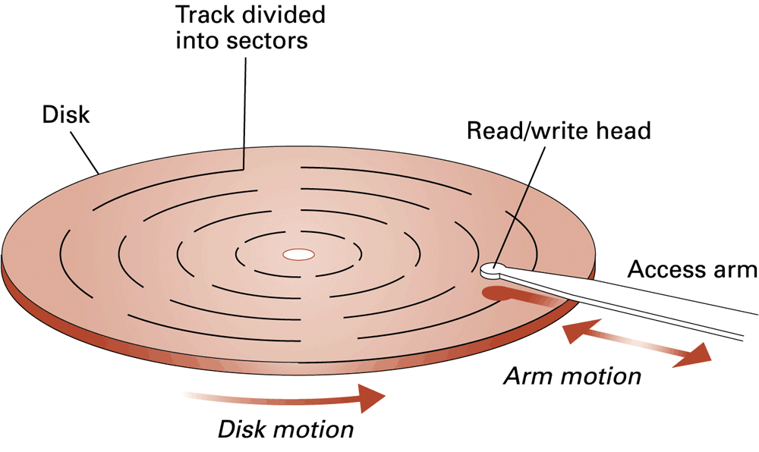
A disk storage system
Notes:
The circular portion of the disk surface that passes under the read/write head
Floppy diskette has 80 tracks on each surface
Hard disk may have 1,000 or more tracks on each surface of each platter

Slide 26
Disk terminology
Track – The circular portion of the disk surface that passes under the read/write head
Sector - Each track is divided into sectors that hold a fixed number of bytes
Cluster - A fixed number of adjacent sectors that are treated as a unit of storage
Cylinder – group of tracks on different platters but in the same location on the platter
Notes:
Zone recording assigns more sectors to tracks in outer zones than those in inner zones
Sector – pizza slice
Read/write head on same location for each platter – faster to store data on one cylinder

Slide 27
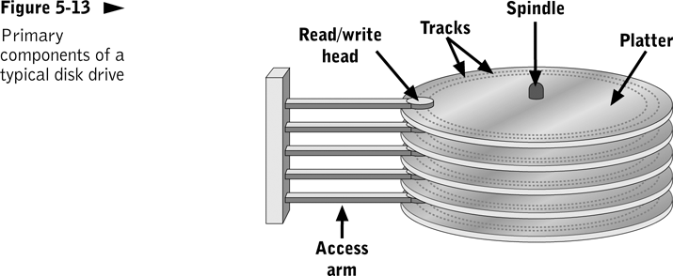

Slide 28
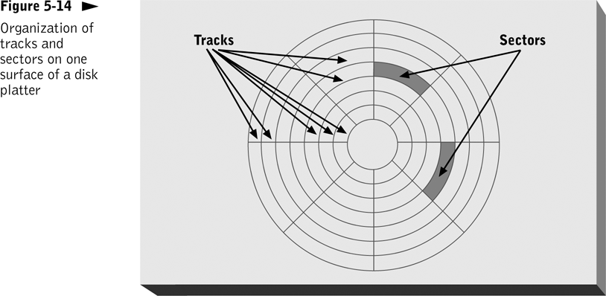

Slide 29
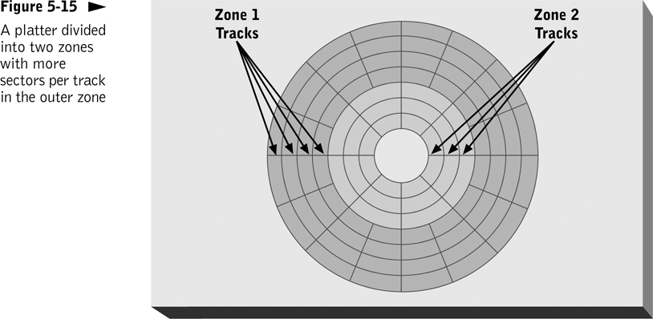
To increase capacity per platter, disk manufacturers divide tracks into zones and vary the sectors per track in each zone.

Slide 30
Magnetic Disk Access Time
Head-to-head switching time
Track-to-track seek time
Rotational delay
Most important performance numbers
  Average access time
  Sequential access time
  Sustained data transfer rate

Slide 31
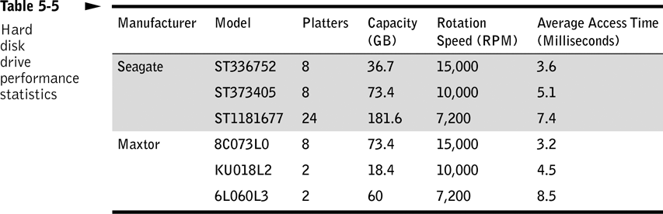

Slide 32
4.5 Optical Mass Storage
Store bit values as variations in light reflection
Higher areal density and longer data life than magnetic storage
Standardized and relatively inexpensive
Uses: read-only storage with low performance requirements, applications with high capacity requirements, and where portability in a standardized format is needed

Slide 33
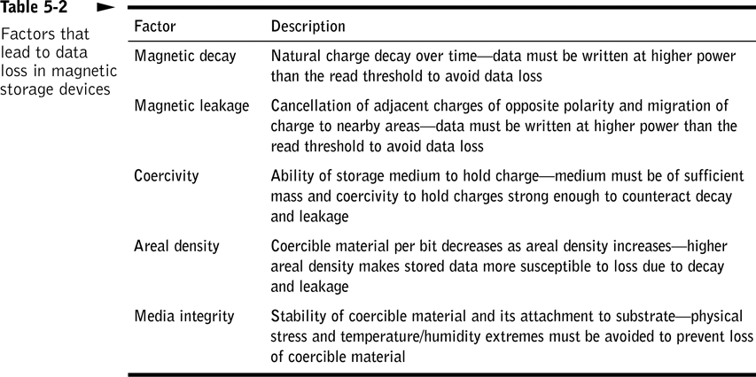

Slide 34

Compact Disks
CD-ROM - drive can only read data from CDs
  CD-ROM stores up to 700 MB per disk
  Primary medium for software distribution
CD-R - drive can write to disk once
  Disk can be read by CD-ROM or CD-R drive
CD-RW - drive can erase and record over data multiple times
  Some compatibility problems trying to read CD-RW disks on CD-ROM drives
Notes:
CD-R used for Write once read many WORM – only write once
Same disks for audio and data

Slide 35
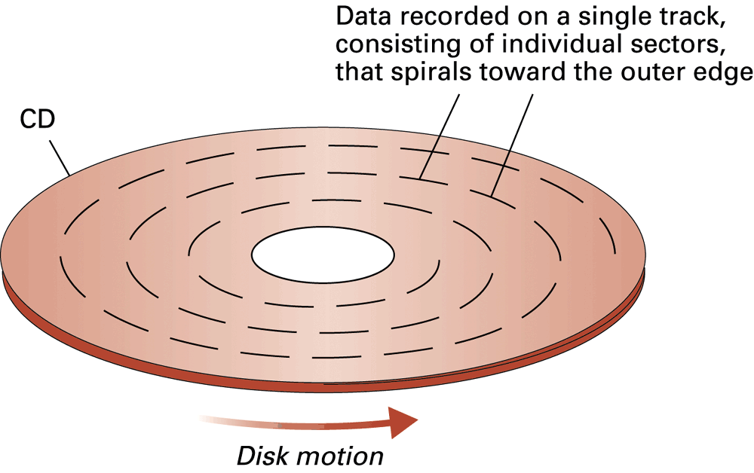
CD storage format

Slide 36
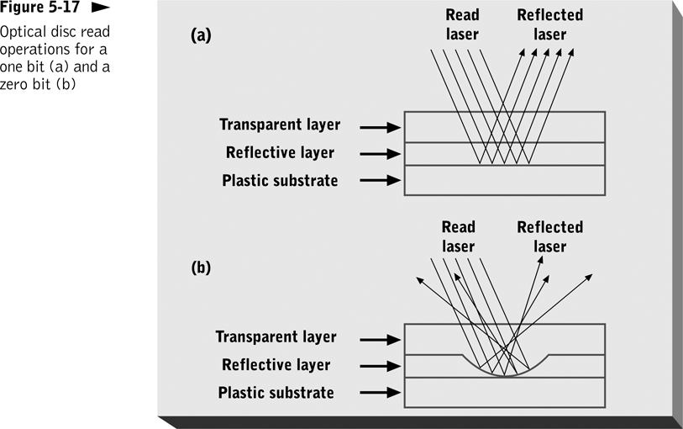
Optical storage devices read data by shining laser beam on the disc.

Slide 37
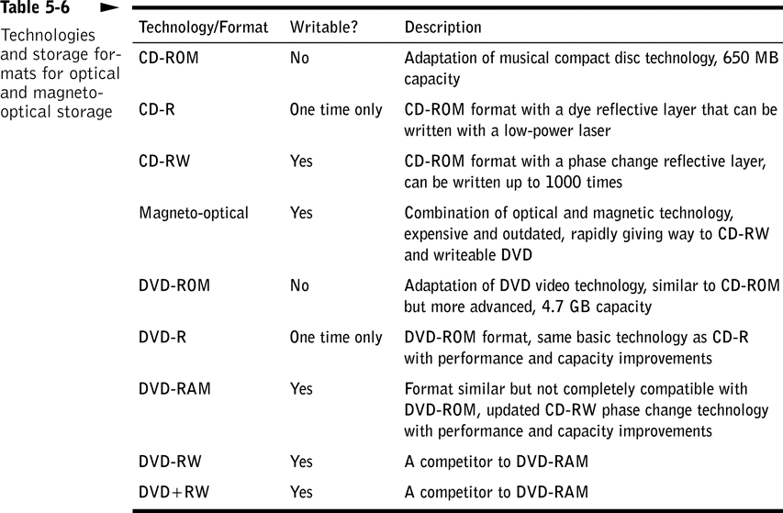

Slide 38
CD-ROM
Read-only; data permanently embedded in durable polycarbonate disc
Bit values represented as flat areas (lands) and concave dents (pits) in the reflective layer
Data recorded in single continuous track that spirals outward from center of disc
Popular medium for distributing software and large data sets

Slide 39
CD-ROM
Advantages | Drawbacks
Standardized format High density Cheap to manufacture | Cannot be rewritten Capacity limited to 700 MB

Slide 40
CD-R
Uses a laser that can be switched between high and low power and a laser-sensitive dye embedded in the disc
Relatively cheap
Common uses: create music CDs on home computers, back up data from other storage devices, create archives of large data sets, and manufacture small quantities of identical CDs

Slide 41
Magneto-Optical
Uses a laser and reflected light to sense bit values
Technology peaked in the mid 1990s
Advantages over CD-RW in access speed and capacity

Slide 42
Phase-Change Optical Discs
Enables nondestructive writing to optical storage media
Materials change state easily from non-crystalline (amorphous), to crystalline, and then back again
  Reflective layer is a compound of tellurium, selenium, and tin
Example: CD-RW

Slide 43
Digital Versatile Disk (DVD)
Short wavelength laser can read densely packed spots
  DVD drive can read CD-ROMs
  Capacity up to 17GB
  Allows for full-length movies
  Sound is better than on audio CDs
Several versions of writable and rewritable DVDs exis
Notes:
Uses shorter wavelength to scan and can compress more data on disk
Equipped to handle MPEG
Standards for compressing video
Standards – DVD+, DVD-RAM, DVD-

